Slide 1

DATA ANALYTICS AND VISUALIZATION(24DSB3101)
An Explainable AI-Driven Big Data Analytics Framework for Climate Prediction and Environmental Risk Assessment
Batch – 6
2420030591 – L. Mrudani
2420090003 – Sri Kruthi
2420090107 – P. Hasitha

Slide 2
Problem Statement:
Climate change produces large and complex datasets involving temperature, rainfall, greenhouse gases, sea levels, extreme weather events, and other environmental indicators.
Existing AI and machine-learning models can provide accurate predictions, but many of them operate as black-box models, making it difficult to understand why a particular climate or environmental risk prediction was generated.
Therefore, there is a need for a scalable Big Data Analytics and Explainable AI (XAI) framework that can predict climate-related risks while providing understandable explanations of the factors influencing those predictions.

Slide 3
Project Objectives:
To identify and visualize important climate and environmental trends, patterns, relationships, and risks through comprehensive data analysis.
To leverage predictive analytics and explainable AI techniques to identify environmental risk levels and the factors influencing them.
To enhance the existing system, we propose a Multi-Source Climate Intelligence Framework that integrates weather, satellite, IoT, and historical disaster data using Big Data Analytics, Machine Learning, and Explainable AI for comprehensive environmental risk prediction.
To provide clear, interactive, and data-driven insights that can support environmental monitoring, planning, and informed decision-making.
To develop an interactive data analytics dashboard for analyzing climate and environmental data from multiple sources.

Slide 4
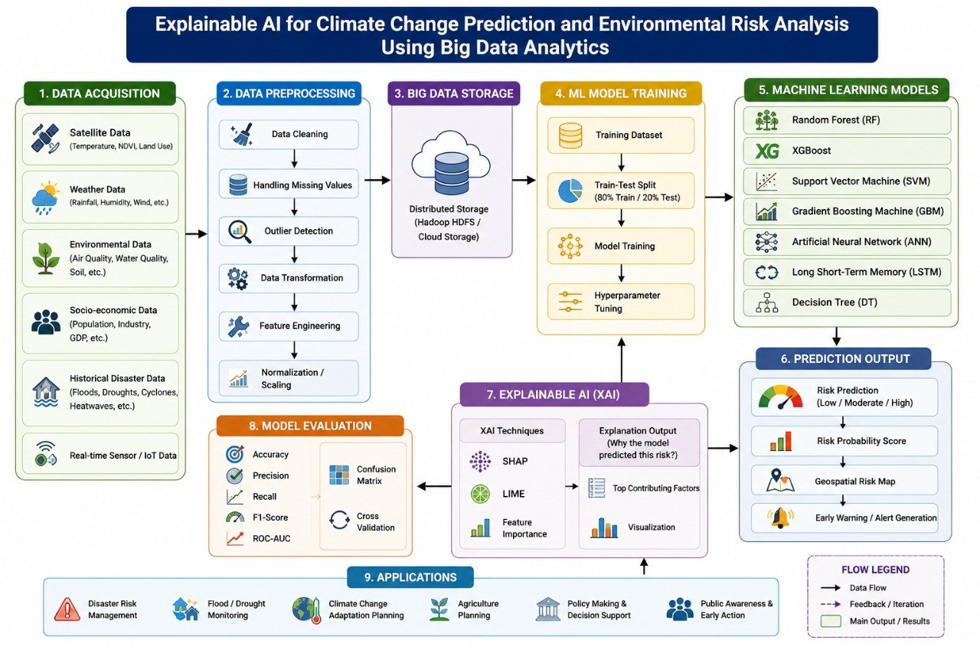

Slide 5
Literature Survey:
Climate Prediction using AI/ML: Previous studies have used machine learning algorithms such as Random Forest, SVM, and neural networks to predict climate variables like temperature, rainfall, and extreme weather events.
Big Data for Environmental Analysis: Researchers have used large-scale climate and environmental datasets from satellites, sensors, and government sources to identify patterns and improve prediction accuracy.
Explainable AI (XAI): Techniques such as SHAP, LIME, and feature importance have been applied to explain AI predictions, making climate-risk models more transparent and understandable.
Environmental Risk Prediction: Recent research focuses on predicting risks such as floods, droughts, heatwaves, wildfires, and other climate-related disasters using AI-based models.
Research Gap: Many existing models focus mainly on prediction accuracy, while limited work combines big-data analytics, climate prediction, environmental risk assessment, and explainability in a single framework. This creates an opportunity for an integrated XAI-based climate risk prediction system.

Slide 6
Research Gaps Identification:
Many climate prediction models focus primarily on prediction accuracy rather than interpretability.
Several AI-based climate models function as black boxes, making their decisions difficult for environmental researchers and policymakers to understand.
Existing studies often focus on one climate variable or one type of environmental risk rather than combining multiple factors.
Large-scale heterogeneous climate datasets create challenges in data processing and scalability.
XAI techniques are not consistently integrated with Big Data-based climate analytics.
Limited research combines climate prediction + environmental risk assessment + explainability in a single framework.
Many studies evaluate models technically but provide limited explanation of which environmental factors drive the predicted risk.

Slide 7
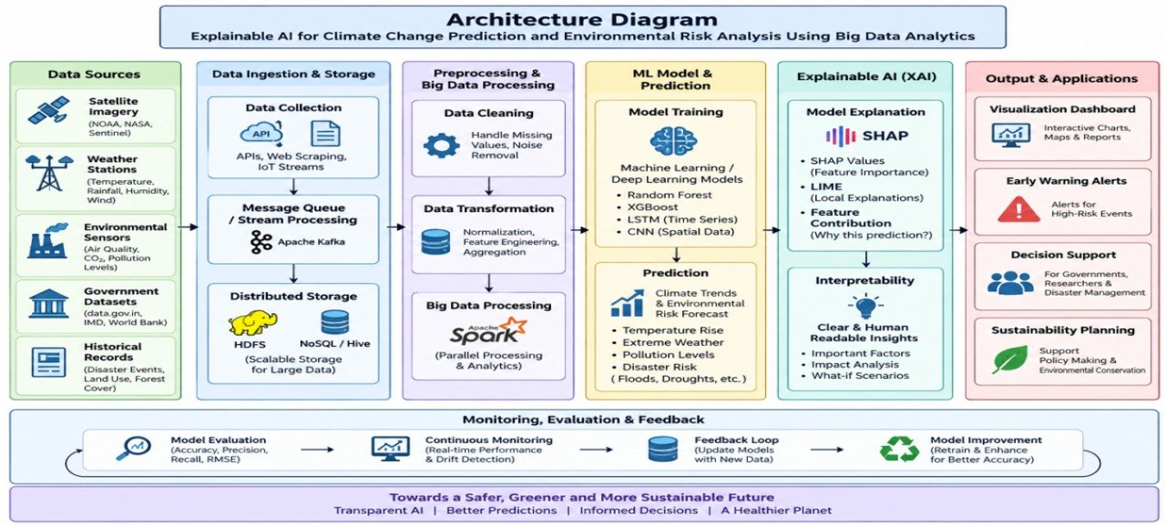
Project Plan:

Slide 8
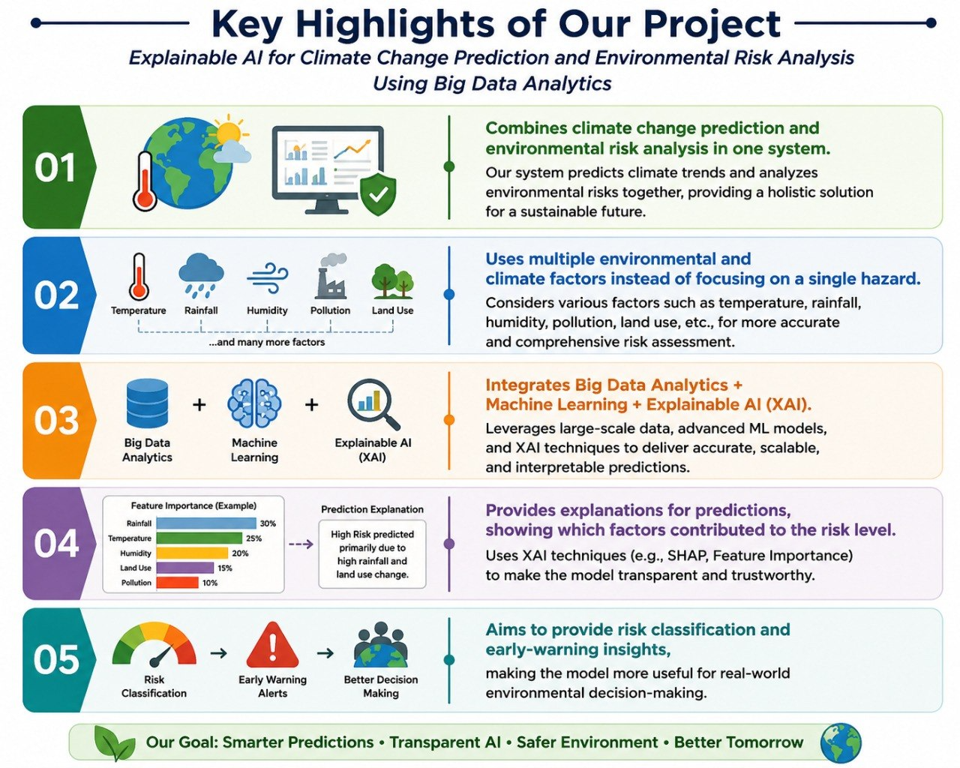
Proposed Work and Its Uniqueness:
- Combines climate change prediction and environmental risk analysis in one system.
- Uses multiple environmental and climate factors instead of focusing on a single hazard.
- Integrates Big Data Analytics + Machine Learning + Explainable AI (XAI).
- Provides explanations for predictions, showing which factors contributed to the risk level.
- Aims to provide risk classification and early-warning insights, making the model more useful for real-world environmental decision-making.

Slide 9
References:
[1] “Comparative Analysis of Various Machine Learning Models That Aim at Analyzing Climate Change and Extreme Weather Patterns,” IEEE Conference Publication, 2025.
[2] “Prediction of Flooding Due to Heavy Rainfall in India Using Machine Learning Algorithms: Providing Advanced Warning,” IEEE Xplore, 2022.
[3] “Predicting and Mapping Flood Susceptibility: Leveraging Explainable AI and GIS Techniques,” IEEE Conference Publication, 2025.
[4] “Flood Risk Assessment and Interpretation Using Explainable AI,” IEEE Conference Publication, 2025.
[5] “Explainability of Machine Learning Models for Hydrological Time Series Forecasting: The Case of Neuro-Fuzzy Approaches,” IEEE Conference Publication, 2023.
[6] “Maximizing Prediction Accuracy in Wildfire Severity: A Comprehensive Analysis of Machine Learning Models Using Environmental Features,” IEEE Conference Publication, 2023.
[7] “Flood Forecasting with Classical and Quantum Machine Learning Models: A Comparative Analysis,” IEEE Conference Publication, 2024.
[8] “Federated Learning-Based Flood Forecasting Model Enhancing Predictive Accuracy and Privacy in Flood Prediction,” IEEE Conference Publication, 2024.
[9] “Flood Prediction and Adaptive Farming Solutions Using IoT, Machine Learning, and Remote Sensing for Climate-Resilient Agriculture,” IEEE Conference Publication, 2025.
[10] “AI and Climate Protection: Research Gaps and Needs to Align Machine Learning with Greenhouse Gas Reductions,” IEEE Conference Publication, 2024.

Slide 10
Thank You

